Slide 1

KIT-KALAIGNARKARUNANIDHI INSTITUTE OF TECHNOLOGY
COIMBATORE - 641402
Approved by AICTE Affiliated to Anna University, Chennai
Accredited With ‘A’ Grade by NAAC & By NBA
DEPARTMENT OF ELECTRONICS AND COMMUNICATION ENGINEERING
Review 2
IoT-Based Smart Two-Wheeler Safety and Rider Authorization System
BATCH NO : 19
TEAM MEMBERS : SATHIYA PRIYA S – 711523BEC100
SUGANTHAN B – 711523BEC110
RANJITH K – 711523BEC310
GUIDED BY : DR S.CHINNAPPARAJ

Slide 2
OBJECTIVE
To develop an IoT-based smart two-wheeler system that prevents unsafe riding by integrating rider authorization, alcohol detection, overspeed monitoring, and supervised learner mode.

Slide 3
PROBLEM STATEMENT
To develop a smart vehicle system that prevents unauthorized access and drunk driving while monitoring overspeed and ensuring safe learner-mode driving through IoT-based alerts and control mechanisms.

Slide 4
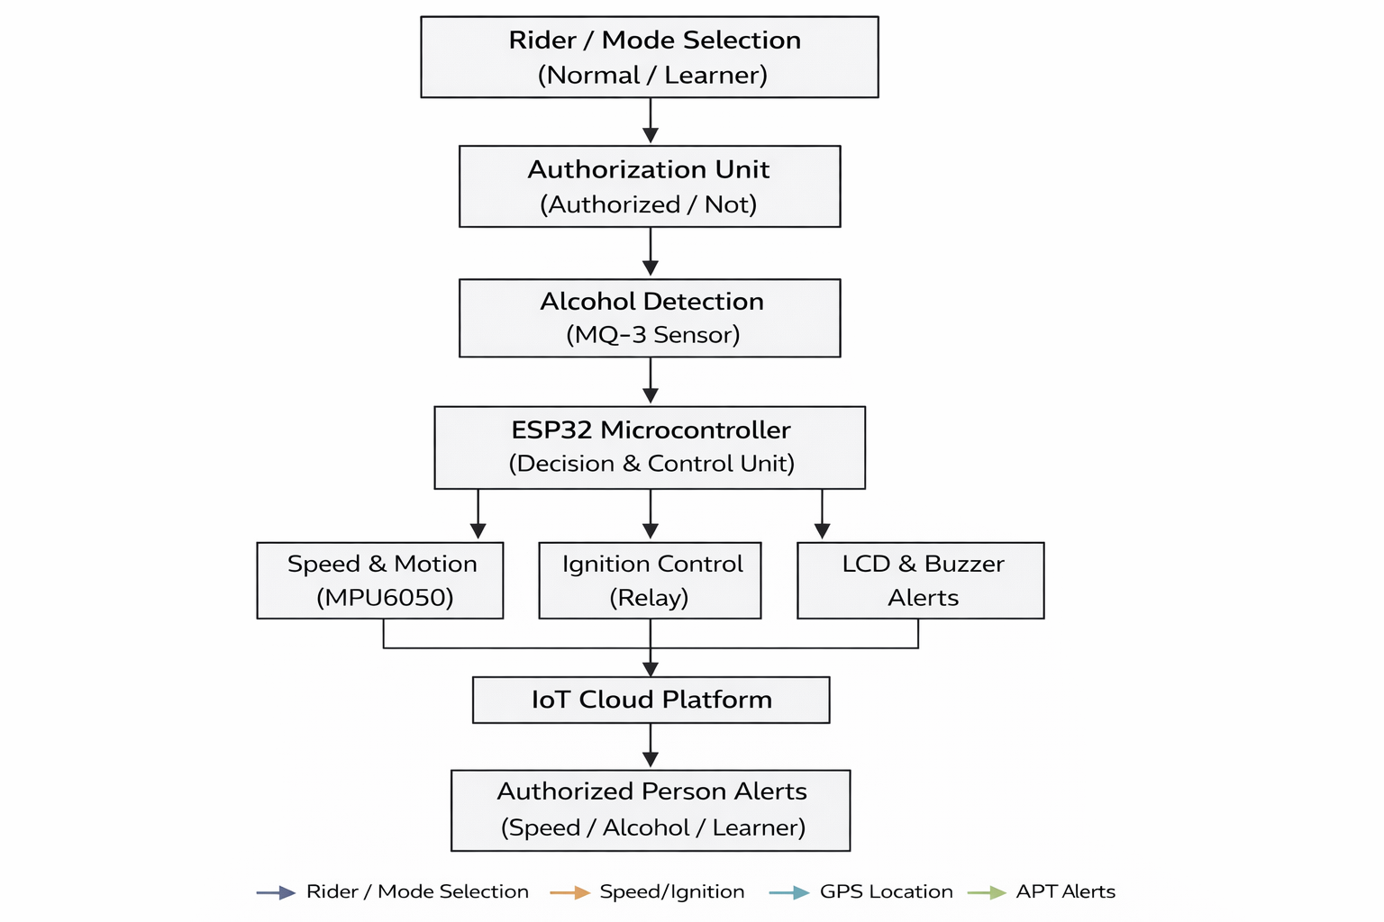
PROPOSED SYSTEM BLOCK DIAGRAM

Slide 5
PROJECT WORKFLOW
Mode selection (Normal / Learner Mode).
Driver authentication and alcohol detection before ignition.
ESP32 processes sensor inputs and executes decision logic.
Relay controls vehicle ignition based on validation.
MPU6050 monitors speed and motion (speed restriction in Learner Mode).
Alerts generated locally and transmitted to IoT cloud for authorized person notification.

Slide 6
WORK COMPLETION STATUS
S.No | Work Description | Completion Status
1 | System Design & Workflow | Completed
2 | Driver Authorization | Completed
3 | Alcohol Detection | Implemented
4 | Learner Mode | In progress
5 | Output | In progress

Slide 7
EXPERIMENTATION
System Design & Workflow Validation
Verified the logical sequence of mode selection, authorization, alcohol detection, and control process.
Driver Authorization Testing
Tested system response for authorized and unauthorized access conditions.
Alcohol Detection Testing
Conducted threshold-based testing using MQ-3 sensor to validate ignition blocking mechanism.
Learner Mode Evaluation (In Progress)
Testing speed restriction logic and monitoring system behavior under learner mode conditions.
Output & Alert Verification (In Progress)
Validating LCD display messages, buzzer alerts, and IoT notification system.

Slide 8
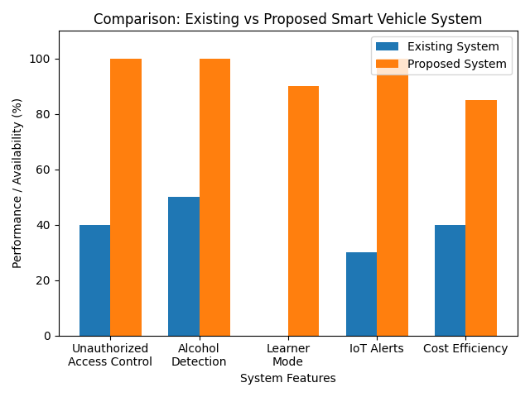
RESULT ANALYSIS

Slide 9
COST CONTROL & RESOURCE UTILIZATION
ESP32 with inbuilt WiFi eliminates need for external communication modules, reducing cost.
MPU6050 used for multi-function motion and speed monitoring, minimizing additional sensors.
Low-cost MQ-3 alcohol sensor and relay-based ignition control ensure economical implementation.
ESP32 efficiently handles data processing, decision logic, and IoT communication.
Optimized power usage suitable for vehicle battery operation.
Integrated local alerts (LCD & buzzer) and cloud-based monitoring for effective resource usage.

Slide 10
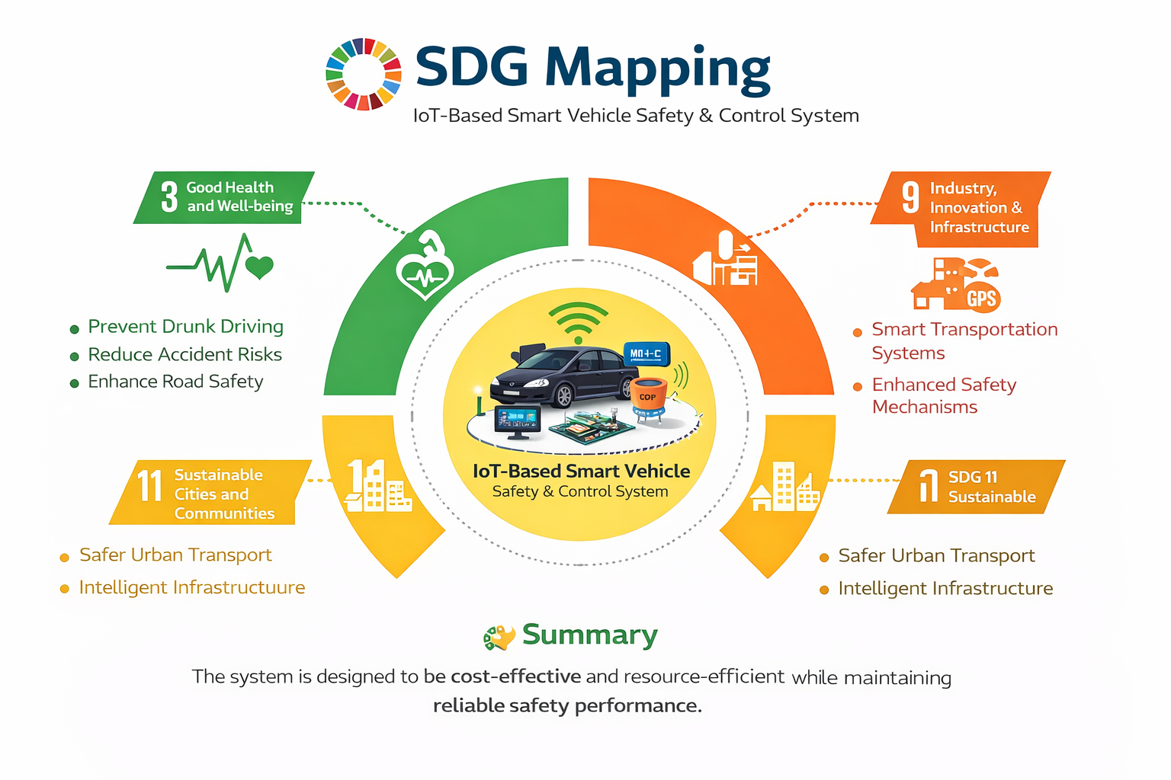

Slide 11
REFERENCES
S.NO | REFERENCE DETAILS
1 | Uzairue, S., Ighalo, J., Matthews, V.O., Nwukor, F., Popoola, S.I. (2018). IoT-Enabled Alcohol Detection System for Road Transportation Safety in Smart City. In: Gervasi, O., et al. Computational Science and Its Applications – ICCSA 2018. ICCSA 2018
2 | I. Sapthami, V. V. Narasimha Raju, V. Vaithianathan, P. Chinnasamy, G. Kumaran and R. K. Ayyasamy, "IoT Based Alcohol Detection and Vehicle Control System," 2024 5th International Conference on Data Intelligence and Cognitive Informatics (ICDICI), Tirunelveli, India, 2024
3 | S. Nanda, H. Joshi and S. Khairnar, "An IOT Based Smart System for Accident Prevention and Detection," 2018 Fourth International Conference on Computing Communication Control and Automation (ICCUBEA), Pune, India, 2018
4 | V. V, J. S. A, S. S, S. P. R, G. T and A. A, "Enhancing Vehicle Safety: A Comprehensive Approach to Accident Prevention Through Alcohol Detection and Ignition Control," 2024 International Conference on Innovative Computing, Intelligent Communication and Smart Electrical Systems (ICSES), Chennai, India, 2024
5 | A. Mukhtar, L. Xia and T. B. Tang, "Vehicle Detection Techniques for Collision Avoidance Systems: A Review," in IEEE Transactions on Intelligent Transportation Systems, vol. 16, no. 5, pp. 2318-2338, Oct. 2015
6 | U. Alvi, M. A. K. Khattak, B. Shabir, A. W. Malik and S. R. Muhammad, "A Comprehensive Study on IoT Based Accident Detection Systems for Smart Vehicles," in IEEE Access, vol. 8, pp. 122480-122497, 2020
7 | K. Muhammad, A. Ullah, J. Lloret, J. D. Ser and V. H. C. de Albuquerque, "Deep Learning for Safe Autonomous Driving: Current Challenges and Future Directions," in IEEE Transactions on Intelligent Transportation Systems, vol. 22, no. 7, pp. 4316-4336, July 2021

